Slide 1

EXECUTIVE SUMMARY : Safety Analysis and Recommendation - United Airlines
Author: Venkat J Jampani
Date: April 25th, 2023

Slide 2
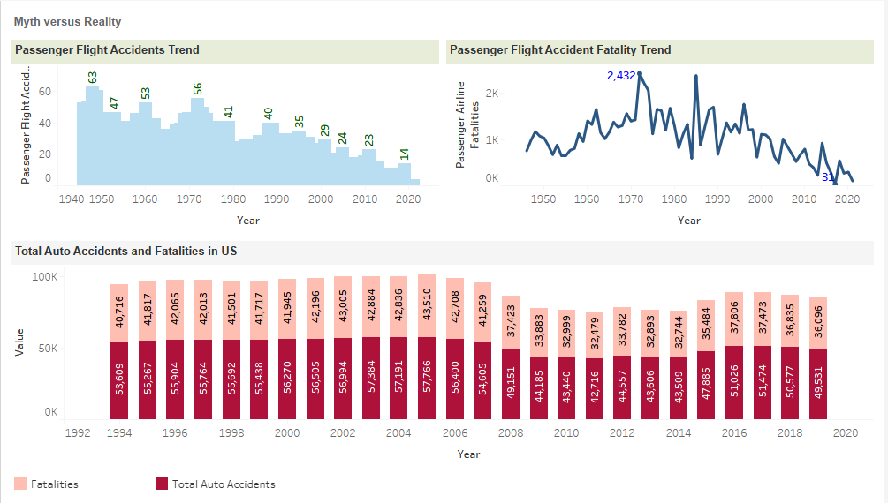
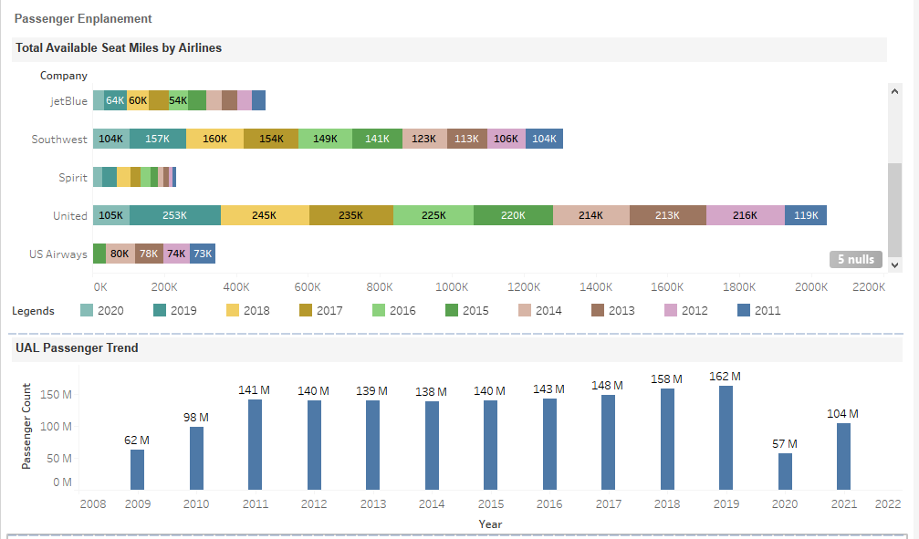
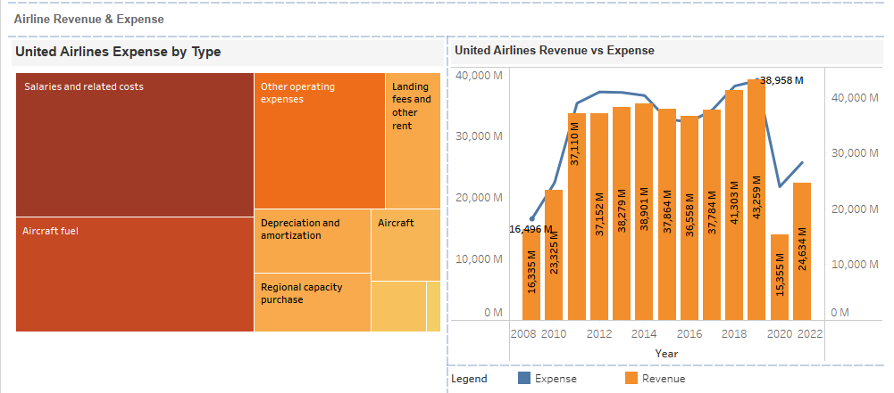
Summary
Myth vs Reality
Media spreading rumors about Airline Safety concerns versus Statistical data.
Passenger Enplanement
Increase in passenger enplanement and available seats, air miles.
Airline Revenue
Covid Impact and increase in revenue over time.
Operating Cost
Impact to income due to increase in operating cost.
Recommendations
Actual Statistics on accidents and fatalities.
Legal and Ethical Considerations
Data Authenticity and compliance.
Revenue Improvement

Slide 3
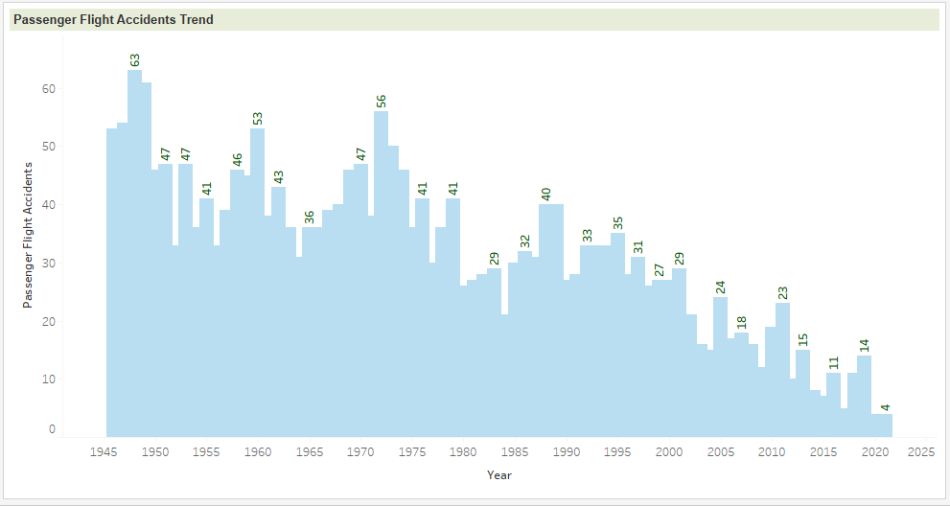
Myth vs Reality Chart Showing Total Passenger Airline Accident over years
Media promoting statistics stating air travel is not completely safe.
Actual data shows the passenger airline accidents incidents are decreasing over the time in the entire world.
Source: Google Document

Slide 4
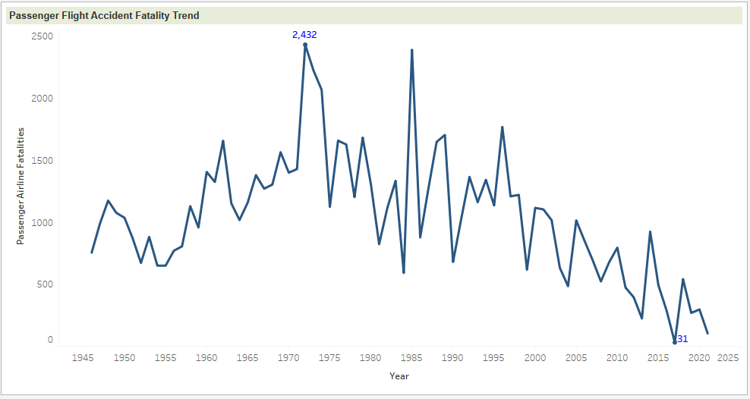
Myth vs Reality Chart showing Passenger Airline Fatality over year
The chart shows the airline fatality count decreases over time.
The fatality count is very less; less than ~0.5 fatality occurred / Millions of flights scheduled in 2019 to 2021 throughout the globe.
Source: Google Document

Slide 5
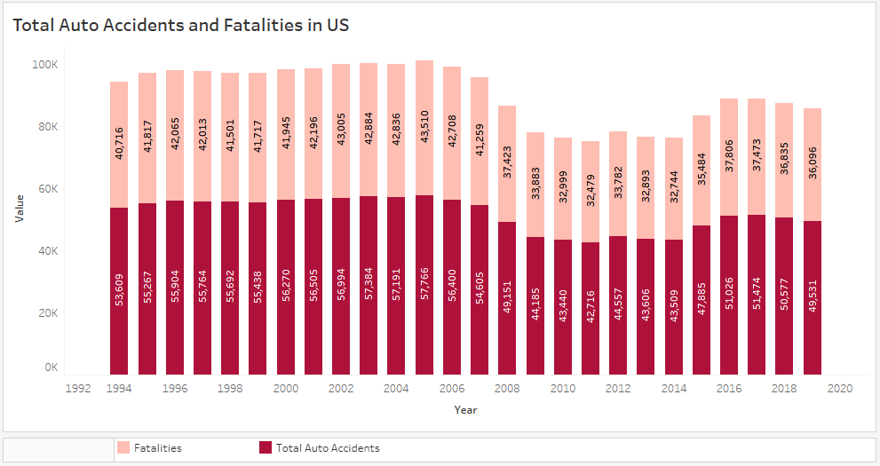
Myth vs Reality Chart showing Auto Accidents and Fatality Trend in United States
This chart shows the auto Accidents and fatality over time in USA.
Total accidents and fatalities for the automobiles is around 50K and ~36K respectively. This number is only for US country.
Comparing the charts, Airline reported accidents and fatalities was way less and not comparable to total ground accidents and fatality reported in US alone.
Source: https://www.nhtsa.gov/

Slide 6
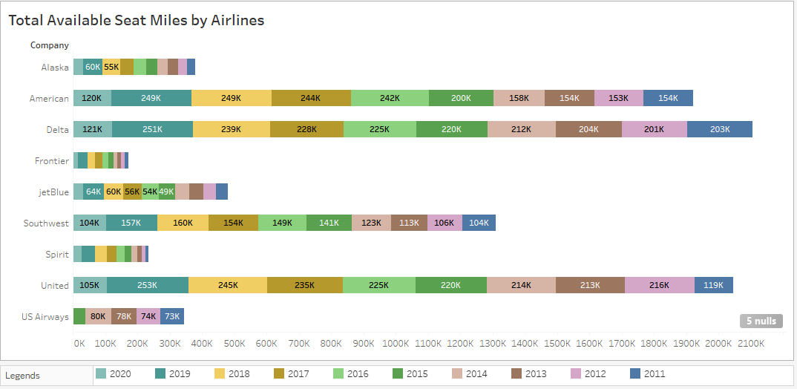
Passenger Enplanement Charts showing total Available Seat Miles Per Airlines
The chart shows the available seat miles has been increased considerably across the airlines.
Increase in total seat miles are seen in American, Delta and United airlines.
United Airlines shows increase in seat miles Pre-Covid (2011 to 2019) and the drop in 2020 is due to Covid situation.
Source: http://web.mit.edu/airlinedata

Slide 7
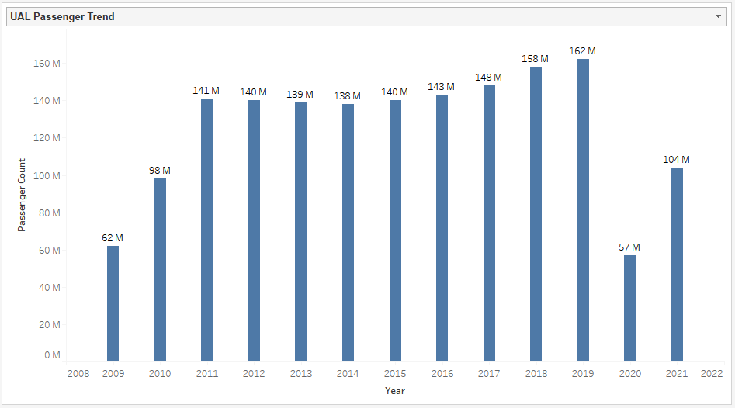
Passenger Enplanement Charts showing Passenger Travelled in UAL over years
The total passenger travelled in United is gradually increasing over years from 2009 to 2019.
Impact in 2020 due to Covid.
Based on the data, it’s clear that passengers travelled in United and other airlines is increasing year over year, with an exception in covid period.
Source: https://expandedramblings.com/index.php/united-airlines-statistics-facts/

Slide 8
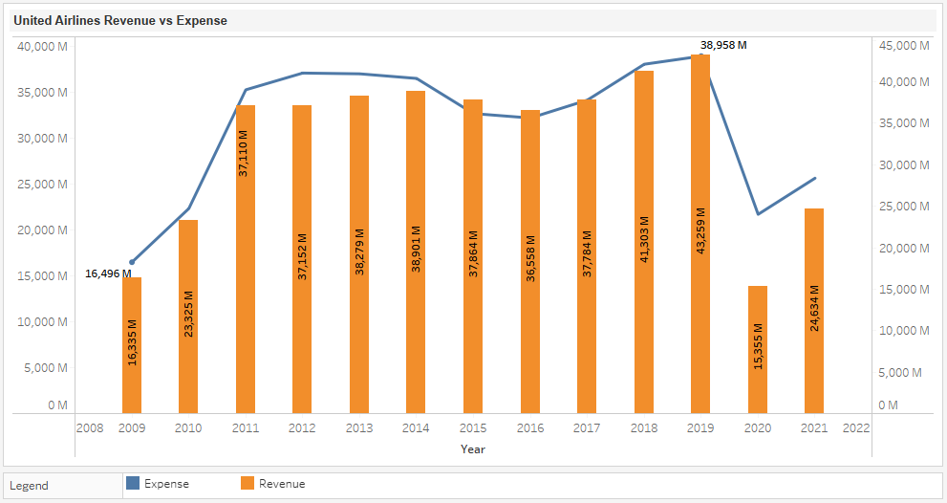
Airline Revenue Charts showing United Airlines revenue and Expense for past decade
Like other airlines, United Airlines revenue has been consistently increased over the years in last decade.
Though revenue is impacted due to Covid in 2020, the revenue started to regain back to 2019 levels.
Management is confidence in long term targets of achieving pre-tax margin targets of 9% 2023 and 14% in 2026.
Source: https://www.macrotrends.net/

Slide 9
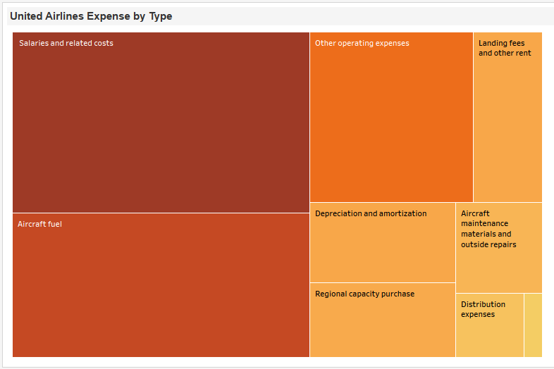
Operating Cost Charts showing Operating expense of United by Type for Q1-22
As revenue increase, the operating expenses also increased over time.
Post Covid, Worldwide Inflation is impacting Airlines operating expenses mainly in salaries and fuel.
Management should focus on controlling Operation expenses by promoting more automation, eliminating repetitive tasks etc.
Source: https://catalog.data.gov/

Slide 10
Recommendations from Statistics
Airline reported Accidents and Fatality (worldwide) was very less and non comparable than the total number of ground accidents and fatalities reported in USA alone.
Management needs to focus on controlling the operating expenses by promoting some automations and eliminating repetitive tasks.
As Covid restriction eases, the people willing to travel surges. So, management should focus on increasing the fleet capacity for 2022 and 2023 to overcome the loss incurred during covid.
Management can attract more passengers by providing offers and holiday packages and compliments.
With the numbers in hand, All airlines should run a combined or individual Campines / advertisements with the safety measures and explaining the benefits of air travel.

Slide 11
Legal and Ethical Considerations Data Authenticity and compliance
No Personal Identifiable Information (PII) and confidential data are used for Analysis.
The data considered for the analysis are shared by government for public benefits.
All data sets are extracted from public websites. The data source used for each chart has been mentioned in the respective slide (below the chart).
There is no restrictions to use this data for Analysis and academic purpose.
Only relevant information required for this analysis is considered.

Slide 12
References Data Sources
Accidents and fatalities:
https://docs.google.com/spreadsheets/d/1SDp7p1y6m7N5xD5_fpOkYOrJvd68V7iy6etXy2cetb8/edit#gid=1448957446
https://www.nhtsa.gov/data
http://www.baaa-acro.com/statistics
Passenger Enplanement:
https://expandedramblings.com/index.php/united-airlines-statistics-facts/
Revenue and Operating Expense:
https://www.airlines.org/impact/
https://www.macrotrends.net/stocks/charts/UAL/united-airlines-holdings-inc/operating-expenses
https://catalog.data.gov/

